Slide 1
Corporate Trainer:Sarita Lad
Technology:

Slide 2


Slide 3
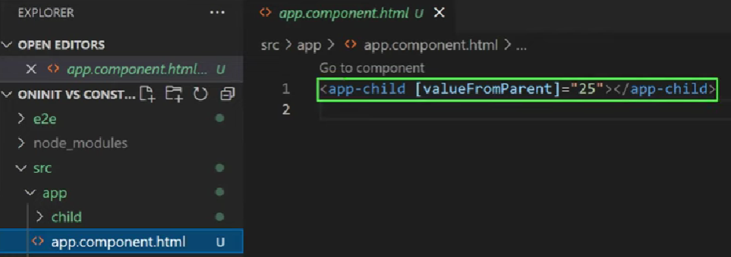
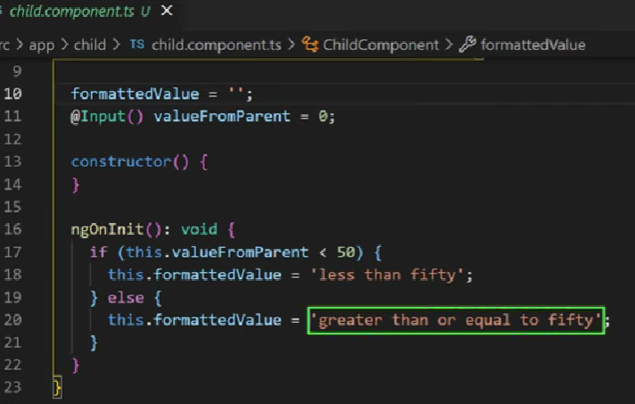

Slide 4
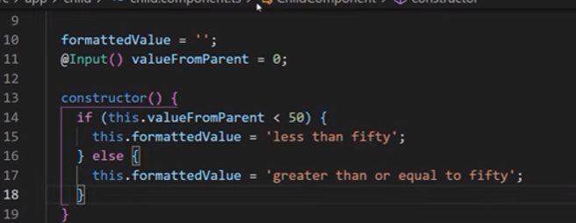


Slide 5




Slide 6
Difference in ProvidedIn and Providers[]
ProvidedIn using @Injectetable decorator provides concise way to use
Shared services in Application
But
Providers [] gives more control over where we want to use the service , on different levels
On Modules or on Component Levels

